Slide 1
Teachers and Students’ Perceptions of the Use of Mobile Technology to Facilitate Teaching and Learning
By
Dr. Paul Nyagorme
Simon-Peter Kafui Aheto
Daniel Kweku Ainooson-Noonoo
College of Distance Education,
University of Cape Coast,
Ghana

Slide 2
Outline of Presentation
INTRODUCTION
Statement of the Problem
Research Questions
Related Literature
Theoretical Framework
METHODOLOGY
RESULT OF THE STUDY
Key findings and discussions
CONCLUSION
Implications of the findings
Recommendations
9/20/2015

Slide 3
INTRODUCTION
Mobile technologies continue to transform pedagogies.
Educational policies on technology use help to enhance pedagogies or slow down progress
Government of Ghana promotes ICT integration in Schools through projects like One Laptop per child, Building of ICT infrastructure for schools, providing ICT training for in-service teachers (in partnership with Indian Government)
However, perceptions of teachers and students on mobile technology seem to vary.
9/20/2015

Slide 4
Statement of the Problem
Limited knowledge in the efficient use of mobile Technology for teaching and learning by most Senior High School (SHS) tutors.
Ban on mobile phone use in SHS
Perception that mobile phone use by SHS students causing poor academic performance of students
Paradigm shift: Mobile phone use by SHS students will allow learning to be fun and interactive (Director ICT, GES)
9/20/2015

Slide 5
Statement of the Problem
Despite the value of mobile phone technology in education, its integration to augment teaching and learning in SHS appear to be untapped
The research therefore seek to explore teachers and students perception on mobile phone technology to facilitate teaching and learning in SHSs in the Cape Coast Metropolis of Ghana
9/20/2015

Slide 6
Research Questions
What are the differences in device ownership among teachers and students?
What are the perceptions of teachers towards the use of mobile technology in the teaching and learning in SHS?
What are the perceptions of students towards the use of mobile technology in the teaching and learning in SHS?
How do the perceptions of students about mobile technology affect the use of mobile technology in the teaching and learning process in SHS?
How do the perceptions of teachers about mobile technology affect the use of mobile technology in the teaching and learning process in SHS?
9/20/2015

Slide 7
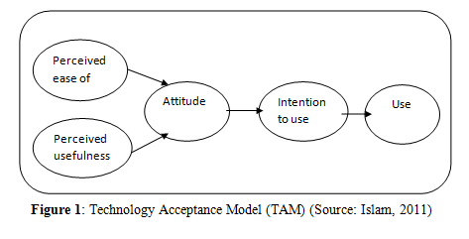
Theoretical Framework
Technology Acceptance Model
9/20/2015

Slide 8
Review of Related Literature
Goundar, (2011) reports that mobile devices are on track to become the main technology for use in education in the future.
According to Kam, Kumar, Jain, Mathur, and Canny, (2008), cell phones are increasingly adopted in the developing world but in the developing countries, there is no training available for teachers on how to use technology to teach or to improve students’ learning (Goundar, 2011).
Ally (2009), reports that rather than acquiring another technology to receive learning materials, people throughout the world will want to access learning materials on their existing mobile devices.
With mobile devices increasing ubiquity in developing countries, Brown (2003) argues that it is reasonable to envision a future where the mobile devices play a pivotal role in education.

Slide 9
Review of Related Literature Continued
Donner (2009) states a good number of studies that consider mobile devices as a resource for e-learning in Tanzania (Stone, Lynch, and Poole, 2003) and Thailand (Whattananarong, 2005). All did agree that the mobile device’s portability, simplicity, and affordability makes it a natural fit for education initiatives in places where PCs and internet connectivity may be scarce.

Slide 10
Review of Related Literature Continued
Akers, Ksoll, & Lybbert, (2010) reports the short-term results from a randomized evaluation of a mobile phone literacy and numeracy program (Project ABC) in Niger, in which adult literacy students learned how to use mobile phones as part of a literacy and numeracy class.
Kam et. al. (2008) believe that learning English as a Second Language [ESL] by playing games on cell phones presents an opportunity to dramatically expand the reach of English learning, by making it possible to acquire ESL in out-of-school settings that can be more convenient than school.

Slide 11
Review of Related Literature Continued
Bhan (2011), a South African teacher says “I have been teaching for 35 years and had never seen anything like it, until the mobile phones came”
Weinberger (2011) suggested that technology should not add burden to teachers and the failure of almost all educational technology initiatives can usually be traced to the additional burden placed on the teacher.

Slide 12
METHODOLOGY
Research Design: Descriptive study
Population: Target population- Teachers and students from 5 selected SHSs in the Cape Coast Metropolis in Ghana. Accessible population- 300 students and 75 teachers
Sampling: Simple random technique
Instrument: Survey, researchers’ observations
Data Analysis: Data presented in percentages and frequencies with the help of Statistical Package for Social Sciences (SPSS) Version 21.
9/20/2015

Slide 13
RESULTS OF THE STUDY
Research Question 1: Device ownership among teachers and students?
9/20/2015

Slide 14
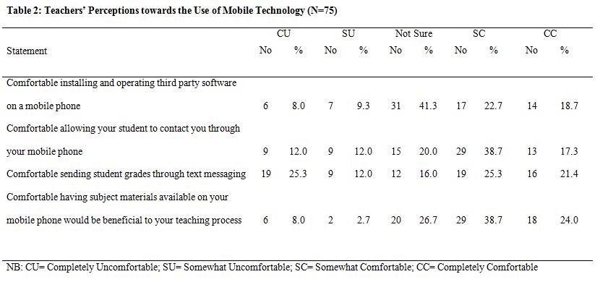
RESULTS OF THE STUDY
Research Question 2: Teachers’ perceptions towards Use of Mobile Technology
9/20/2015

Slide 15
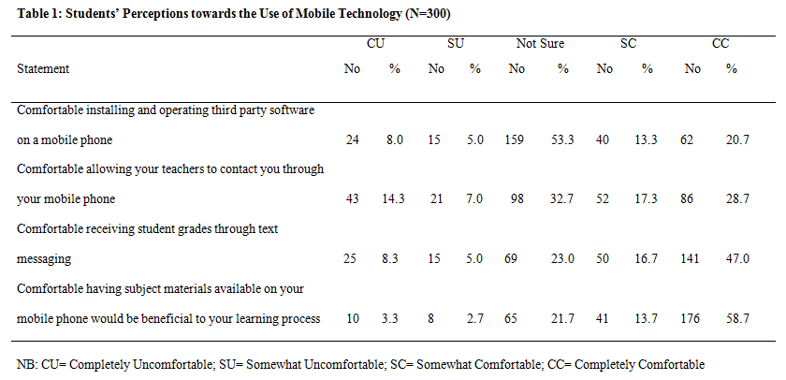
RESULTS OF THE STUDY
Research Question 3: Students’ perceptions towards Use of Mobile Technology
9/20/2015

Slide 16
RESULTS OF THE STUDY
Research Question 4: Effects of Teachers’ and Students’ perceptions of Mobile Technology on the teaching and learning process in SHS
9/20/2015

Slide 17
RESULT OF THE STUDY
Research Question 5: Effects of Teachers’ and Students’ perceptions of Mobile Technology on the teaching and learning process in SHS
9/20/2015

Slide 18
Some key findings and Discussions
The study found that majority (84.7%) of the students in the Metropolis had mobile phones as compared to those with personal computers
More than half of both the teachers and students also indicated that they would like to use mobile devices to support their teaching and learning.
More than half of both teachers and students believe that having course materials accessible from their mobile phones will be beneficial to the teaching and learning process.
9/20/2015

Slide 19
Conclusion
The ban on the use of mobile technologies is inhibiting pedagogical opportunities that can promote teaching and learning in SHSs in Ghana
Ownership of mobile technologies can be basis of integrating them into the curriculum where necessary.
Training of teachers and sensitization of stakeholders in education in the use of mobile technologies can promote efficient use of the technologies to enhance teaching and learning in SHSs
9/20/2015

Slide 20
Implications of the findings
Mobile phones would be much easier and less expensive to integrate into the teaching and learning curriculum.
Both teachers and students want to learn at their own pace.
Teachers and students perceive to use mobile technologies and also perceive that mobile technologies will be useful in the teaching and learning process.
9/20/2015

Slide 21
Recommendations
The ban on mobile phone usage in SHSs should be lifted to give way for more objective considerations for mobile technologies into teaching and learning in SHSs in Ghana
Retooling of teachers in Pedagogies in mobile technologies
INSET on integration for teachers, students and telecommunication companies on mobile technology for teaching and learning at SHS level very important.
Future researchers investigate the use of mobile technologies in improving adult literacy.
9/20/2015

Slide 22
Thank you.
9/20/2015

