Slide 1

The eLearning Maturity Model (eMM): A framework to enhance the systematic implementation of eLearning policies?
Antoinette Mukendwa

Slide 2
Introduction
Transformation into a University of Science and Technology
Integration and implementation of eLearning in all the institutions key activities
The question is no longer to implement eLearning or not; it is rather, how far along are you in this process?

Slide 3
Problem statement
eLearning was implemented as a fourth mode of learning at the Polytechnic of Namibia in 2010
An eLearning policy is in place
5 years on, the institution still does not have a fully fledged online programme
Notes:
eLearning was implemented at the Polytechnic of Namibia in 2010.
An eLearning strategy and policy are in place
and yet the institution does not have a fully fledged programme as yet.

Slide 4
Aim
Evaluate the eLearning capability of the Polytechnic of Namibia using Marshall’s (2007) eLearning Maturity Model (eMM) methodology
Explore ways in which maturity models assist in improving standards and the quality of eLearning activities at the PoN
Notes:
Framework this paper intends to show how an eLearning Maturity Model can be used to encourage improvements in eLearning at the institutions.

Slide 5
Maturity Model
What is a Maturity Model?
instruments that rate and determine the evolutionary progression of an institutions capability to design, plan, initiate, manage and evaluate eLearning activities with the sole aim of being used as a framework to guide improvement in all spheres of eLearning
Notes:
Capability in the context of this model refers to the ability of an institution to ensure that eLearning design, development and deployment is meeting the needs of the students, staff and institution. Capability includes the ability of an institution to sustain eLearning support of teaching as demand grows and staff change.

Slide 6
Capability
What does it mean to be eLearning capable?
Capability in the context of this model refers to the ability of an institution to ensure that eLearning design, development and deployment is meeting the needs of the students, staff and institution. Capability includes the ability of an institution to sustain eLearning support of teaching as demand grows and staff change.

Slide 7
eLearning Maturity Model (eMM)
The eMM was established from the Capability Maturity Model (CMM)⁷ and Software Process Improvement and Capability dEtermination (SPICE)
The eMM has evolved since inception in 2002 to the current version 2.3 2007
The eMM divides the capability of institutions to sustain and deliver eLearning into 5 major process areas which are further broken down into 35 processes
Each process in the eMM is broken down within 5 process dimensions called practices that are either essential (in bold) or just useful (in plain text)
The eMM also consists of 5 capability assessments
Notes:
Marshall and Mitchell’s (2002) eLearning Maturity Model Framework was established from the Capability Maturity Model (CMM) as pioneered by Watts Humphrey in the field of Software engineering (Marshall & Mitchell, 2002)

Slide 8
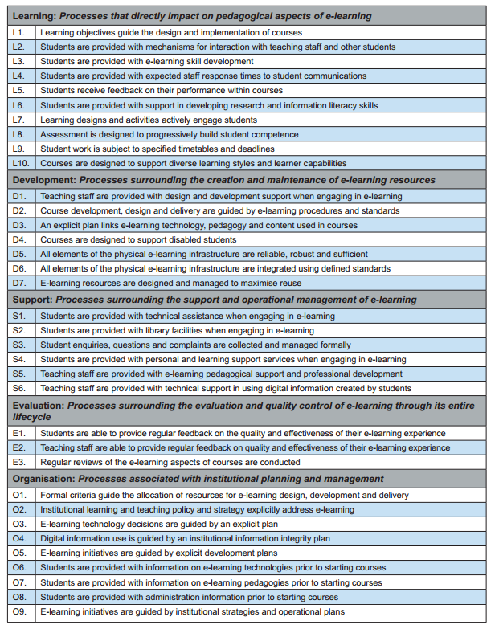
eMM
eMM processes

Slide 9
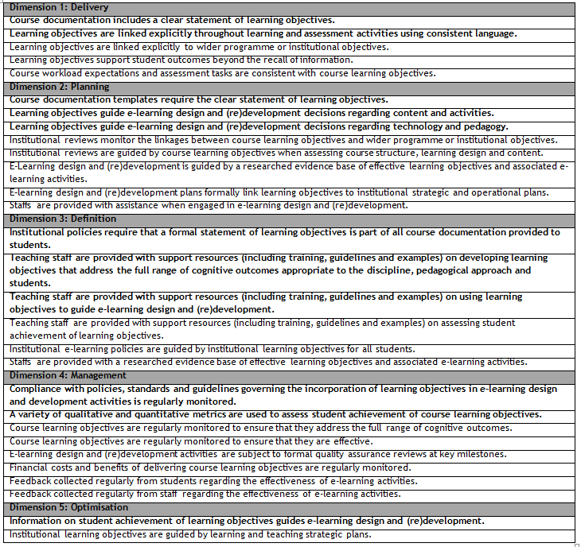
eMM
eMM dimensions and practices

Slide 10
eMM
Table 4: eMM Capability Assessments
eMM Capability Assessments |  | Brief description
 | Fully adequate | This rating indicates that the process outcomes are currently being clearly and sustainably addressed
 | Largely adequate | This rating indicates that the practice outcomes are evident
 | Partially adequate | This rating indicates that major shortcomings or limitations in practice outcomes are evident
 | Not adequate | This rating indicates that there is currently no evidence of the practice occurring in the institutional context
 | Not assessed

Slide 11
eMM
Over 80 different institutions have assessed their eLearning capability using the eLearning Maturity Model
eMM capability assessment enables comparative capability visualisations
guiding and focusing continuous improvement and attainment of goals
the eMM combines key features of benchmarking and capability maturity models with those of observational eLearning quality frameworks in order to create a quality framework for improving eLearning maturity

Slide 12
Methodology
Each individual process description gives a detailed list of sources of information providing evidence of capability
Questions and potential documents which can be examined when determining institutional capability
These include: institutional policies, documents and strategic plans
Four (4) assessors were asked to complete assessment workbooks for triangulation purposes
Completed assessment workbooks were consolidated into one workbook by averaging out assessment capabilities

Slide 13
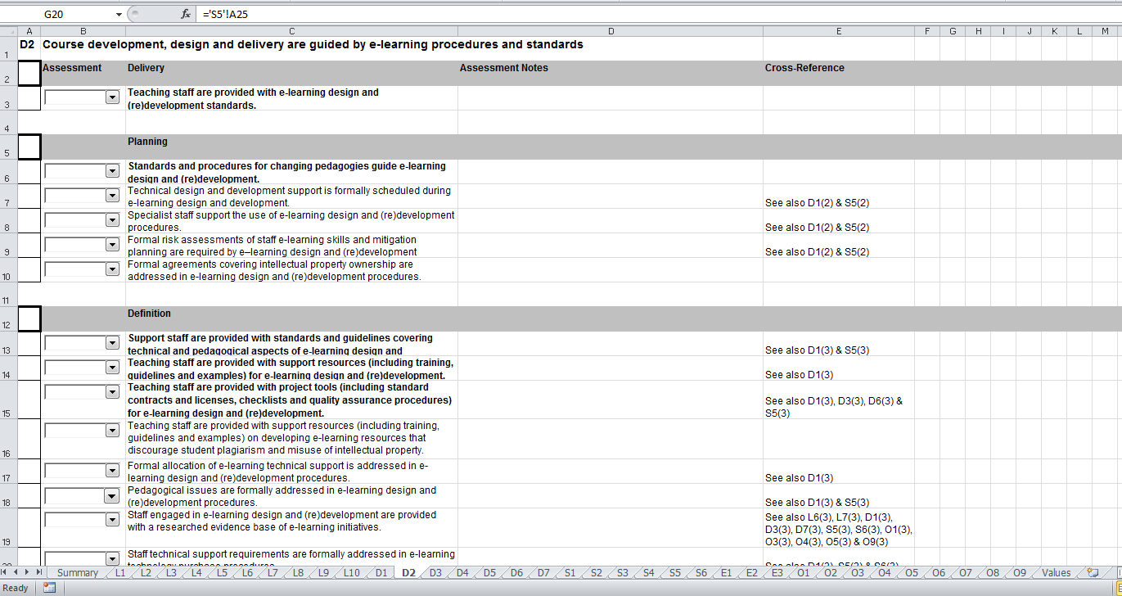
Methodology

Slide 14
Limitations
Not all stakeholders involved in the implementation of eLearning activities at the Polytechnic of Namibia were involved in this study
Not all assessors completed all the sections of the assessment workbook as some sections where beyond their scope

Slide 15
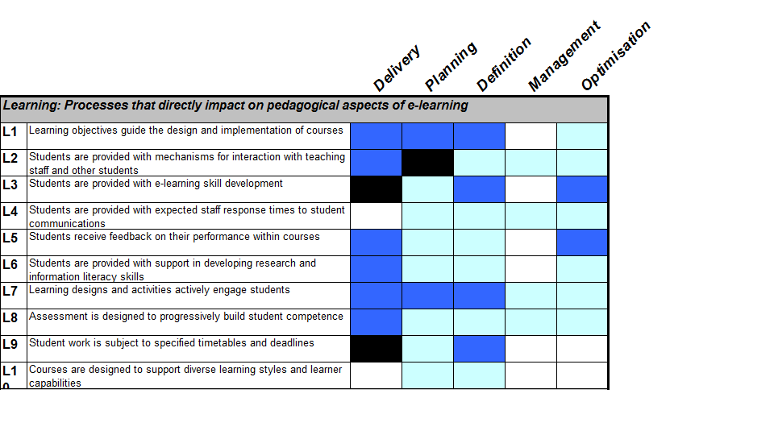
Findings
Learning process category

Slide 16
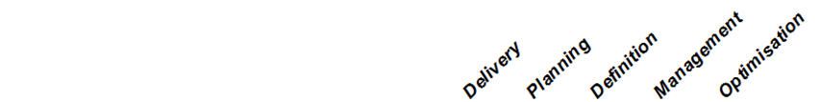
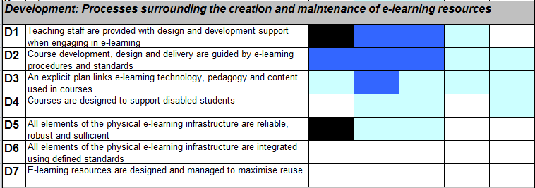
Findings
Development process category

Slide 17
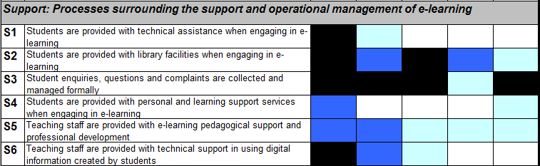
Findings
Support process category

Slide 18
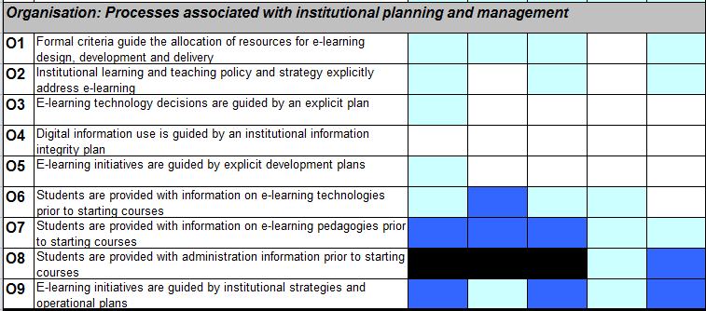
Findings
Organisation process category

Slide 19
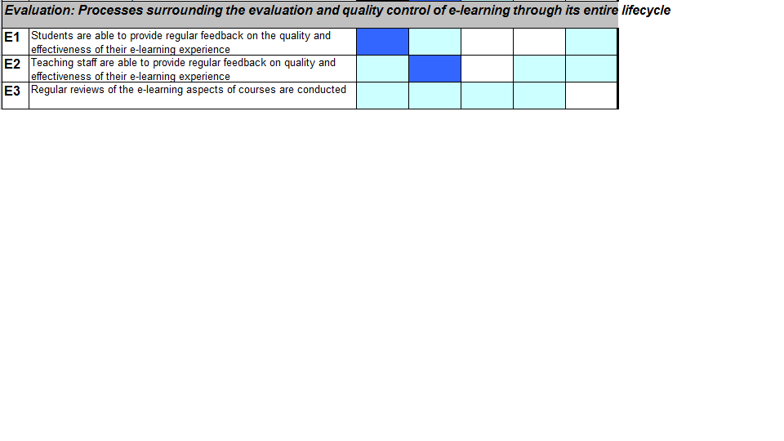
Findings
Evaluation process category

Slide 20
Findings
delivery of processes that directly impact pedagogical aspects of eLearning
delivery of eLearning skill development for students
the delivery of student feedback on their performance within courses
provision of teaching staff with design, development and support when engaging in eLearning
using guided eLearning procedures and standards when designing, developing and delivery eLearning courses
plans in place for linking eLearning technology, pedagogy and content to be used in all courses
eLearning infrastructure that is reliable is in place
delivery of processes surrounding the support and operational management of eLearning.
providing students with administration information before courses start
provided students with information on eLearning pedagogies prior to commencement of courses
eLearning initiatives at the institution are guided by institutional strategies
students are given the opportunity to provide regular feedback on the quality and effectiveness of their learning experience.

Slide 21
Findings
general lack of systems in place to further manage and optimise these processes
staff response times to student communication
eLearning courses are not designed to support diverse learning styles
the integration of eLearning infrastructure using defined standards
the design and management of eLearning resources for maximum reuse
providing technical assistance and personal and learning support services when students are engaging in eLearning.
eLearning institutional planning and management
eLearning evaluation processes
regular reviews of the eLearning aspects

Slide 22
Conclusions
Strengths reflect sustainable practices at an institution.
Most processes are largely adequate in the first three domains; delivery, planning and definition and generally not adequate in the management and optimisation of these processes
Identifying these is vital if the institution wants to maintain that standard but also share best practices with other institutions whether regionally and internationally
With the eLearning policy revision looming, results obtained from the application of this model is essential in informing that process.

Slide 23
Recommendations
Develop merge-able workbooks
organise a workshop session where all assessors are invited to jointly complete the same workbook
A follow up study would be valuable in further cementing advocacy for using the eMM in institutions.
It is however recommended that this follow up research be a collaborative effort amongst institution to explore the benchmarking aspect of the eMM.

Slide 24
References
Marshall, S. & Mitchell, G. (2002). An eLearning Maturity Model? 19th ASCILITE conference. Auckland: Unitec.
Marshall, S. (2010). A quality framework for continuous improvement of eLearning: The eLearning Maturity Model. International Journal of eLearning and Distance Education, 24 (1), p. 143 -166.

Slide 25
THANK YOU!

