Slide 1
Growing open data in Africa
Ms. Nodumo Dhlamini
Director – ICT Services & Knowledge Management
Association of African Universities

Slide 2
Presentation Outline
Introduction to open data
Global and local drivers of the growing open data movement
Overview of the current state of open data in Africa
Insight into who is currently involved in sharing open data in Africa and why

Slide 3
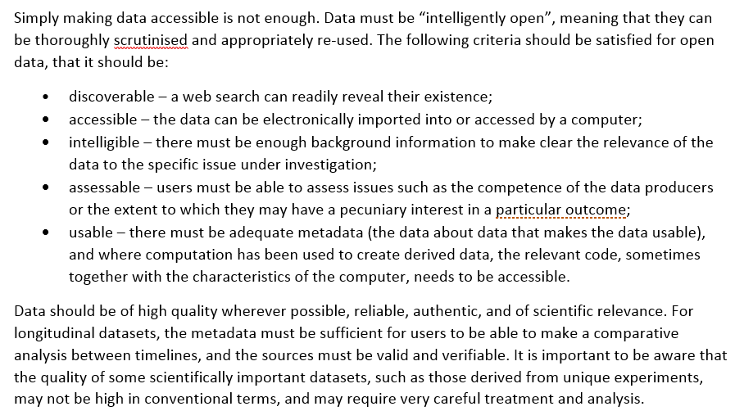
Open Data in a Big Data World: An International Accord - http://www.science-international.org/sites/default/files/reports/open-data-in-big-data-world_long_en.pdf

Slide 4
Global and local drivers of the open data movement
Global Science Requires Open Data – for validation
Big Data revolution
“Data-intensive machine-analysis and machine-learning are becoming universal, and have key implications for science. The complexity of patterns that machines are able to identify are not easily grasped by human cognitive processes, posing profound issues about the human-machine interface and what it might mean to be a researcher in the 21st century”

Slide 5
Global and local drivers of the open data movement
the case for open data as a fundamental pre-requisite in maintaining the rigour of scientific inquiry
Maximising public benefit from the data revolution in both developed and developing countries.

Slide 6
Overview of the current state of open data in Africa
The 3rd Edition of the World Wide Web Foundation’s Open Data Barometer (ODB), released in April 2016 and covering 92 countries, ranks nations on three open data criteria:
Readiness: How prepared are governments for open data initiatives? What policies are in place?
Implementation: Are governments putting their commitments into practice?
Impact: Is open government data being used in ways that bring practical benefit?

Slide 7
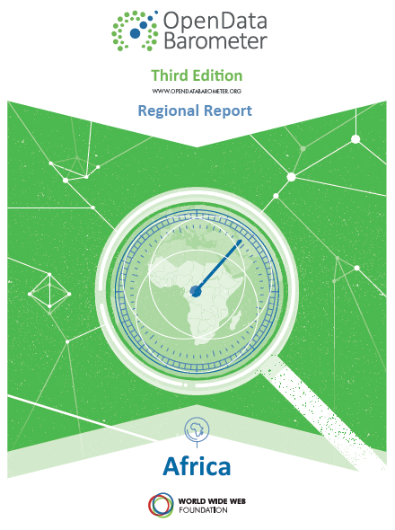

Slide 8
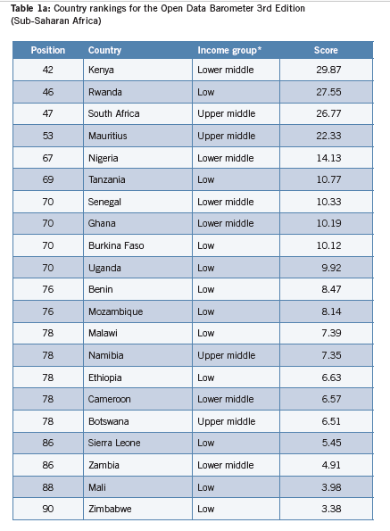

Slide 9
Open Data Barometer (ODB) Findings
Performance across the continent is relatively poor globally, and in comparison to leading countries in the Global South
A downward trend is all too common in the overall Barometer scores from 2013 to 2015.
Open data initiatives lack long-term commitment and resources, resulting in short-term gains that are unsustainable.
ODB implementation scores are lower than readiness scores, and the gap is not closing.
There is no stand-out performer in Africa.

Slide 10
Open Data initiatives in Africa 1
Africa Data Consensus (roadmap to improving data standards and availability across the continent): http://www.uneca.org/sites/default/files/PageAttachments/final_adc_-_english.pdf
African Development Bank (AFDB) Open Data Initiative – boosting access to quality data for monitoring development results in African Countries: http://www.afdb.org/en/knowledge/statistics/data-portal/
African Open Science Platform (implemented by the Academy of Science of South Africa): http://tinyurl.com/hqsb66p

Slide 11
Open Data initiatives in Africa 2
Dakar Declaration on Open Science in Africa: http://www.sci-gaia.eu/dakar-declaration/
Database of African Theses, Dissertations and Research Articles (DATAD-R): http://datad.aau.org/
Data Skills Training: African Institute for Mathematical Sciences - a Next Einstein Initiative: www.nexteinstein.org

Slide 12
Open Data initiatives in Africa 3
Africa Open Data Conference: http://www.africaopendata.net/
Ghana Open Data Initiative (GODI): http://data.gov.gh/
The Kenya Open Data Portal makes Public Government datasets accessible for free to the public in easy reusable formats, supporting the Government's drive to proactively inform citizens and be accountable - http://www.opendata.go.ke/

Slide 13
Open Data initiatives in Africa 4
Open Data Developments in West Africa: http://www.ictworks.org/2016/06/29/the-status-of-open-data-initiatives-in-west-africa/
JKUAT in consultation with CODATA developed and implemented an open research data policy (JORD) in Feb 2016

Slide 14
Motivation for sharing open data in Africa
Donor Driven?
To drive continental / global goals promoting democracy and development.
Improved services
Efficiencies and public-private collaboration
Accountability
Constituent Engagement
Proactive Transparency

Slide 15
CONCLUSIONS
The Open Data Barometer shows that there are some African countries committing to the implementation of their open data programs.
Most initiatives in Africa have focused on the government programs
The involvement of universities and researchers in developing and implementing open research policies is at infancy stage in Africa
Need for capacity building, awareness and building of robust data infrastructures

Slide 16
References
http://www.science-international.org/sites/default/files/reports/open-data-in-big-data-world_short_en.pdf
http://www.codata.org/news/150/62/African-Open-Science-Platform-to-boost-the-impact-of-open-data-for-science-and-society-Media-Release
http://opendatabarometer.org/3rdedition/regional-report/africa/
http://junar.com/blog/understanding-motivations-for-your-open-data-program/

