Slide 1
Social Media Adoption By Nigerian Universities-How Have They Fared?
Olufemi Jeremiah Olubodun University of Lagos, Faculty of Dental Sciences, College of Medicine, Idi-Araba, Lagos.
ojolubodun@cmul.edu.ng; #ojolubodun; www.slideshare.net/ojolubodun

Slide 2
OBJECTIVES
To identify types of social media and their uses generally.
To identify types of social media and uses in higher education institutions.
To identify types of social media used by Nigerian Universities.
To ignite debate on the setback caused for not adequately using social media by Nigerian Universities.
To discuss the prospects of using social media by Nigerian Universities.

Slide 3
How Many Universities do we have in Nigeria?
Broadly Nigerian Universities are:
Federal – Fourty one (41)
State - Twenty five (25)
Private – Sixty one (61)
Source: NUC.edu.ng

Slide 4
WHAT IS SOCIAL MEDIA?
Source: Google

Slide 5
WORLDWIDE USE OF COMMON SOCIAL MEDIA TECHNOLOGIES
FACEBOOK: 1.23Billion monthly active users worldwide
With 945Million mobile users, and 757Million daily users
Source:www.thenextweb.com/facebook
TWITTER: 232Million users Monthly, 6000 Tweets every second which equals 350,000 tweets/minute 500 Milliontweets/day and 200 Billion tweets/ year.
Source: www.internetlivestats.com/twitter-statistics/
YOUTUBE: Over 1Billion Monthly users
Source:www.huffintonpost.com

Slide 6
Social Media Commonly Used By Nigerian Universities
S/N | Social Media Type | Federal Universities(41) | State Universities (25) | Private Universities (61)
1 | Facebook | 18 Universities OUT of (41) | 12 Universities OUT of (25) | 24 Universities OUT of (61)
2 | YouTube | 5 Universities OUT of (41) | 6 Universities OUT of (25) | 12 Universities OUT of (61)
3 | Twitter | 19 Universities OUT of (41) | 26 Universities OUT of (25) | 30 Universities OUT of (61)
4 | Google+ | 5 Universities OUT of (41) | 6 Universities OUT of (25) | 8 Universities OUT of (61)

Slide 7
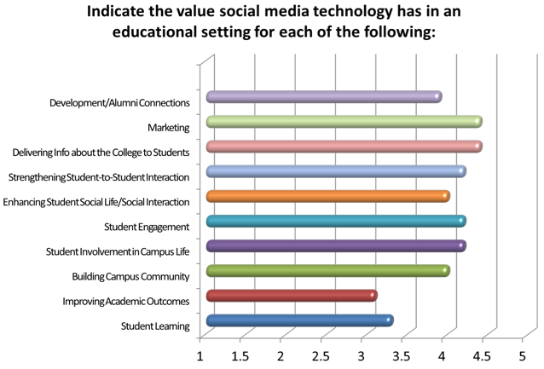
1 = No value, 2 = Minimal value, 3 = Moderate value, 4 = Substantial value, 5 = Great value
Source: http://works.bpress.com/hfdavis/2

Slide 8
FOUR NIGERIAN AND ONE AFRICAN (KENYAN) UNIVERSITIES COMPARED
S/N | Social Media Type | Kenyatta University Founded 1965 | University of Lagos, Lagos. Founded 1962 | University of Ibadan Ibadan, Nigeria. Founded 1948 | University of Nigeria Nsukka Founded 1960 | University of Portharcourt Founded 1975
1 | FaceBook | 68, 421 Likes, 32, 609 Total Visits, 4.1 Rating, 598 reviewer. Used for academic activities and Marketing. | Unilag FB page-27,275 Likes | 47, 883 Likes, Last post: 17th Nov ‘14 | 26,462 Likes, Last post 14th September | 39,040 Likes; 4.1 rating by 329 reviewer, Last post:13/06/15 Posting mostly for marketing
2 | Twitter | FW: 13.1k; FG: 873; TW: Daily tweet | 17 Tweets; 5 FG; 3743 FWs; Last Tweet 23rd Jan 2014 Active since 2011. | Last Tweet, FW:4584 04th Dec ’14; 495FG | 447 Tweet; 1147 FG; 2882 FW. | 2757 FW; 9 Tweets
3 | G+ | FW: 1538; Views: 508, 733; Circles: 47; KU in Circles: 1524. | No Official Page | Not active | NA | 197 Connections
4 | LinkedIn | Active Page | No Official Page | 287 Connections | NA | No official Page
5 | Vimeo/You Tube | 50 subscribers 9,196 views Joined 9 Jul 2014 | No Official Page | No Official Page | 76 subscribers 2,393 views Joined 9 Jun 2012 | 2 Videos, 111 Views. Vimeo
6 | RSS feed | Nil | No official page | Not Active | NA

Slide 9
MORE NIGERIAN UNIVERSITIES
S/N | Social Media Type | University of Benin, Benin City Founded 1970 | University of Maiduguri Founded 1975 | Usmanu Danfodio University Sokoto. Founded 1975 | University of Jos, Nigeria. Founded 1975 | Bayero University , Kano. Founded 1975
1 | FaceBook | No official Page | 29,234 Likes; FW; Last Post 6/11/14 | No active | App present website but not active | Icon present but not active
2 | Twitter | FW: 2085; FG: 2; TW: 102 Last tweet: 03/08/15 | FG:11; FW:521; TW 13; Last Post: 09/01/14 | Not active | App present website but not active | Icon present but not active
3 | G+ | No official page | No Official Page | Nil | NA | Icon present but not active
4 | LinkedIn | No official page | No Official Page | Nil |  | Icon present but not active
5 | YouTube | 7subscribers 293 views Joined 6 Mar 2014 | No Official Page | Nil |  | NA
6 | RSS Feed | Official page leads to Youtube | No Official Page | Nil |  | Icon present but not active

Slide 10
SOCIAL MEDIA STATUS OF SOME SELECTED UNIVERSITIES OF INTEREST
S/N | Social Media Type | University of Cape Town, South Africa | Cardiff Metropolitan University | Manchester University UK | Massachusetts Institute of Technology (MIT) | New York University, USA.
1 | Facebook | 96, 643Likes’ 20,197 Visits; 4.4 of 5 Stars from 448 reviews | 21,506 Likes, Posting Daily, 4,943 Visits, 4.2of 5 Stars, reviewed by 297. | 95,535 Likes, 44,117 Visits, 4.7 of 5stars from 448 reviews | 712,005Likes | 484, 956 Likes; 170, 107 Visits; 4.5og 4Stars;
2 | Twitter | 5,942 Tweets, 1352 FG; 15.5 FWs; 262Fav, 8Lists Joined April 2012. | 3,236Tweets, 723 FG, 13.2K FWs; 1532Fav’ 8Lists | 2,179 Tweets; 533FG; 14k FWs, 477Fav | 8,970 Tweets, 426FG; 239kFWs; 290 Fav; 9Lists. Tweet daily. | 5, 703 Tweets; 1,012FG; 58.6kFWs, 1218Fav; 20Lists Joined April 2009
3 | G+ | Nil | 4,042 FWs; 15,124 Views | 22, 298 FWs; 25,284,731 Views
4 | LinkedIn | 1st Degree connect 24; 2nd degree connect 2770 | Not examined |  | Nil | 61,474 FWs
5 | YouTube | 634307 | 371 Subscribers; 64, 330 views-Joined 30/04/2012 Other Social media: iTunes, Flickr,Instagram etc. | 6487 Subscribers Other Social media:Instagram | 102,195 Subscribers; 28,228 Views, Joined 14/01/2009. | 484,956 Likes, 170,107 Visits; 4.5 of 5 Stars
6 | RSS Feed |  | Nil

Slide 11
INFERENCES RESULTING FROM WEB SCRUTINY
Nigerian Universities are not social-Websites are not active and do not provide spaces for collaboration among academics within and outside the universities
Scrutiny of social media sites even some websites return with the following results: Account suspended, web not available, or web not responding etc.
Elsewhere in the outside world universities use social media for fostering connection among present, past and prospective students, strengthening interaction among students, promote life within campus, engaged for academic works, marketing , BLOGS are used to keep record of students’ activities (e.g. volunteering) as a portfolio for future advantage in seeking employment etc.

Slide 12
CONCLUSION
Nigerian Universities need to do better by interacting with the outside world of academics i.e. provide platform for students, staff and educators outside the University system to interact, share and collaborate with their counterparts on both individual and University wide basis taking advantages of social media with greater accessibility advantage.

